Slide 1
Metamodeling for TCR phosphorylation

Slide 2
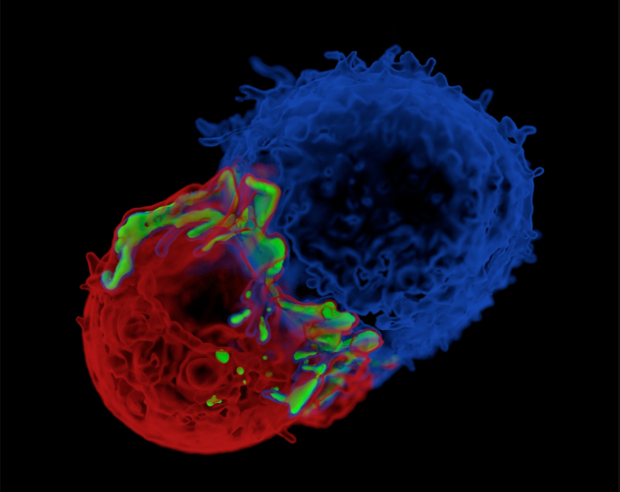
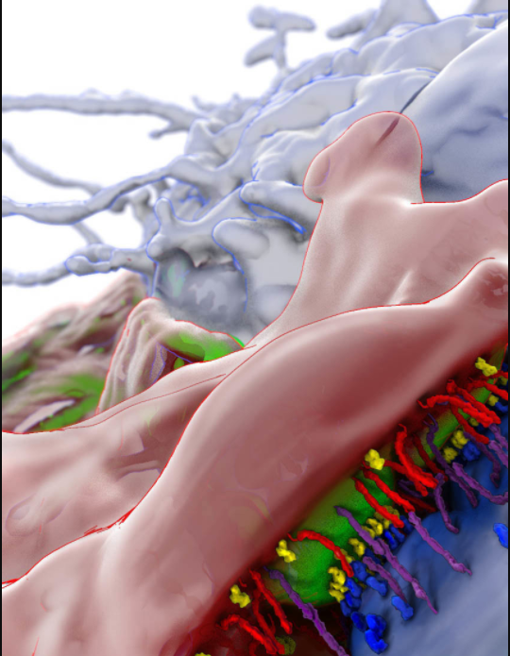
Background
T cell
Antigen Presenting Cell (APC)
Zap70 molecules
T cell
APC
Zap70
TCR
MHC
CD45
LFA-1/ICAM
2µm
50nm
James JR, Vale RD. “Biophysical mechanism of T-cell receptor triggering in a reconstituted system”. Nature. 2012

Slide 3
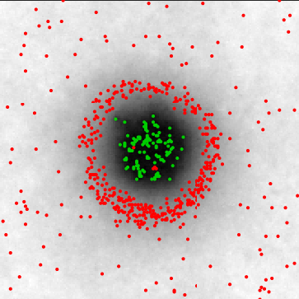
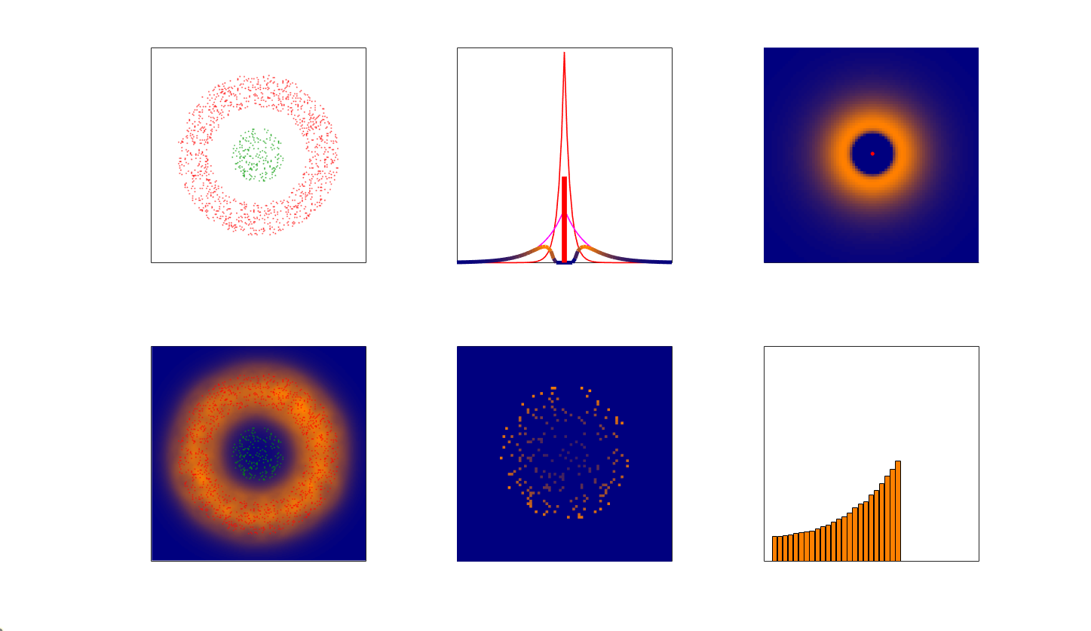
The three models
Kinetic segregation
Lck activation
TCR phosphorylation

Slide 4
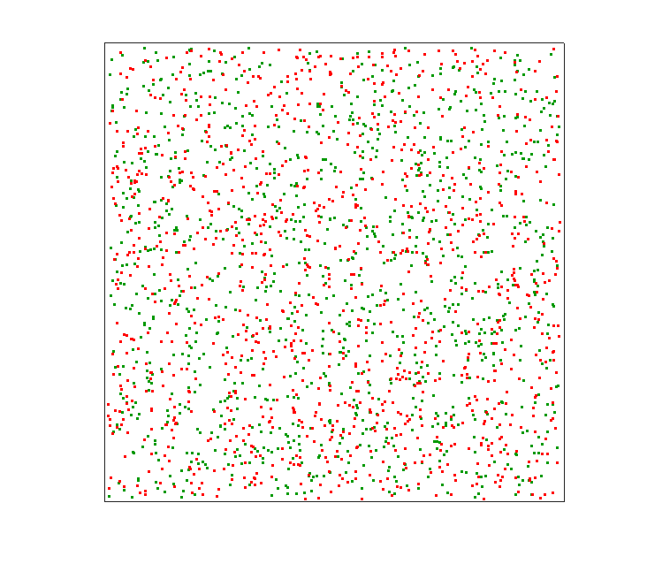
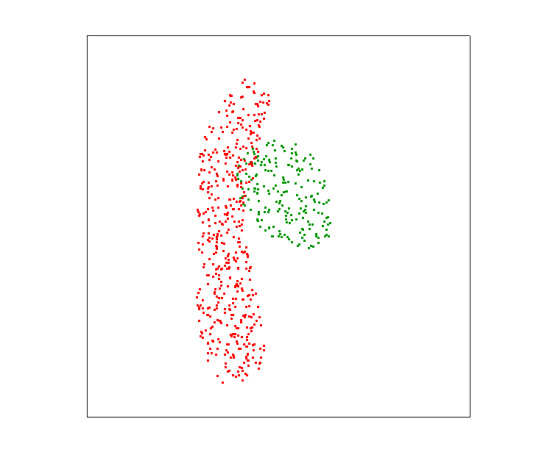
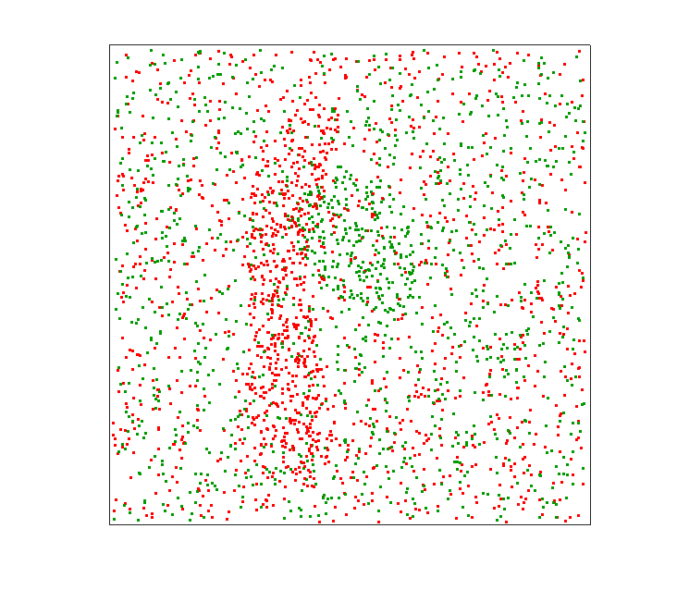
Model 1: Kinetic segregation
What does it mean ‘segregation’? Segregation of what?
What does it mean ‘kinetic’?
What is the configuration at the initial contact?
What is the configuration at the ‘final’ contact? What does it mean ‘final’?
Uniform
Clusters
Uniform and Clusters
2000
Y(nm)
1000
0
0
1000
2000
0
1000
2000
0
1000
2000
X(nm)
X(nm)
X(nm)

Slide 5
Model 1: Kinetic segregation
Δz(nm)
Interactions
50
Physical model
40
Attraction
Repulsion
T-cell
i,j
30
CD45
20
Δz_{i,j}
TCR
10
pMHC
0
APC
0
K_{B}T

Slide 6
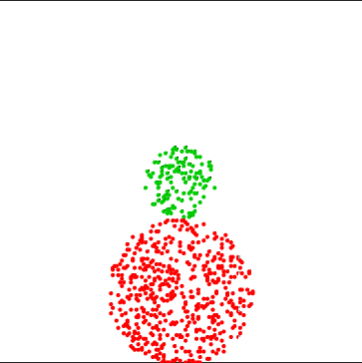
Model 1: Kinetic segregation
T-cell (initial)
T-cell (final)
2000
70 nm
1000
Y(nm)
t = 0
t = 100sec
0 nm
0
0
1000
2000
0
1000
2000
X(nm)
X(nm)

Slide 7
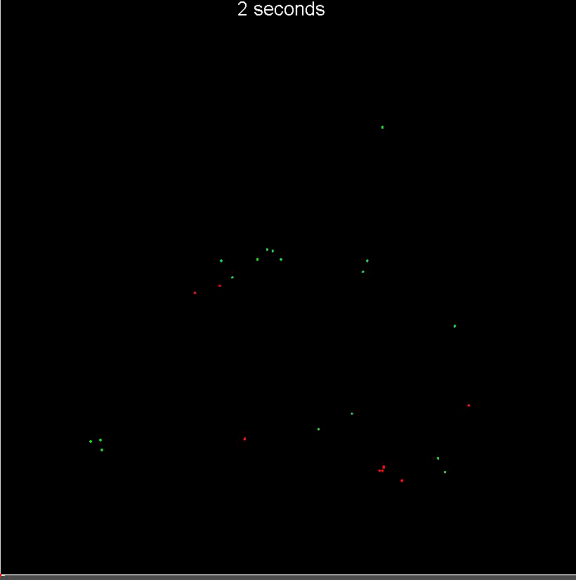
Model 1: Kinetic segregation

Slide 8
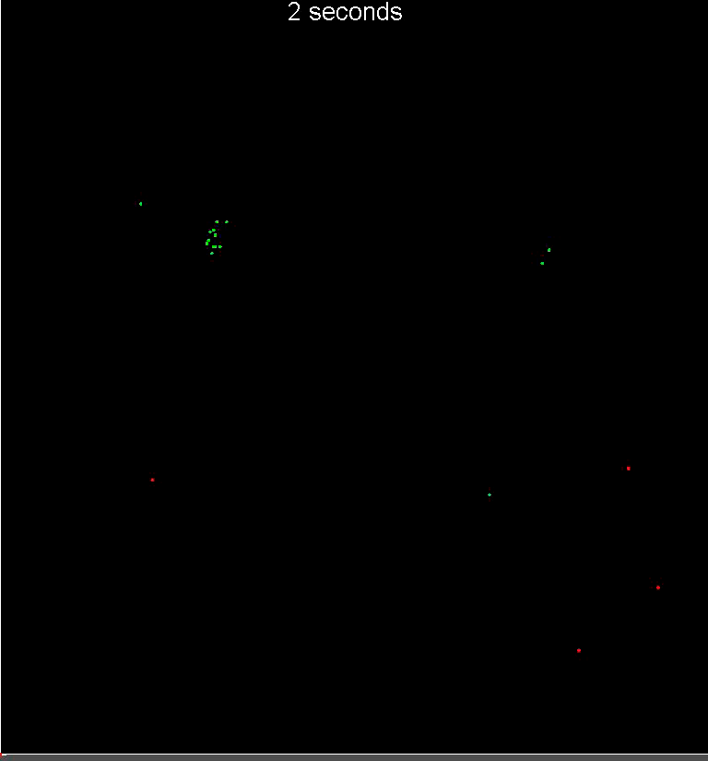
Model 1: Kinetic segregation

Slide 9
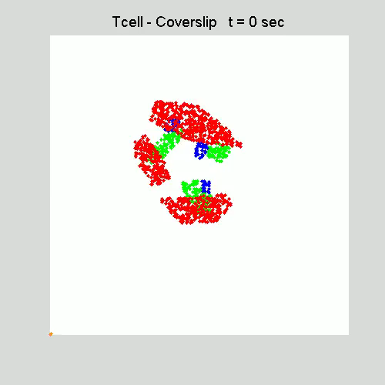

Model 1: Kinetic segregation

Slide 10
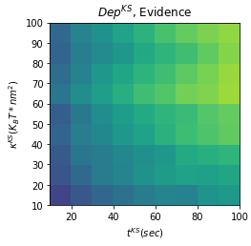
Model 1: Kinetic segregation

Slide 11
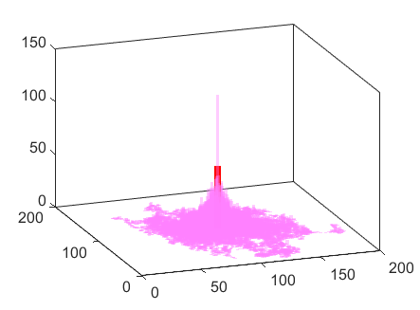
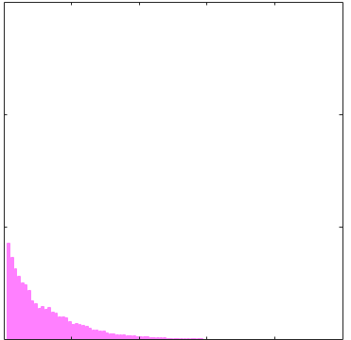
Model 2: Lck activation
random walk and activation
Active LCK distribution
Radial density of active LCK
150
inactive
LCK
100
active
LCK
Counts
Radial density
Activation
By CD45
50
inactive
LCK
Y(nm)
Spontaneous
deactivation
X(nm)
0
0
500
1000
r(nm)

Slide 12
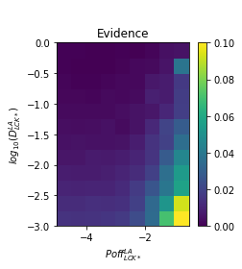
Model 2: Lck activation

Slide 13
Model 3: TCR phosphorylation
Points pattern
Phosphorylation probability
Phosphorylation probability
1000
400
CD45
TCR
CD45
Lck*
Combined
CD45
0.2
0
0
y(nm)
Probability
y(nm)
0.1
-1000
0
-400
-1000
0
1000
-400
0
400
-400
0
400
x(nm)
x(nm)
x(nm)
Points pattern with Prob. distr.
TCR phos. probability
Radial distributions of TCR*
1000
400
0.2
CD45
TCR
TCR*
0
0
0.1
y(nm)
y(nm)
y(nm)
-1000
-400
0
-1000
0
1000
-400
0
400
0
200
400
x(nm)
x(nm)
r(nm)

Slide 14
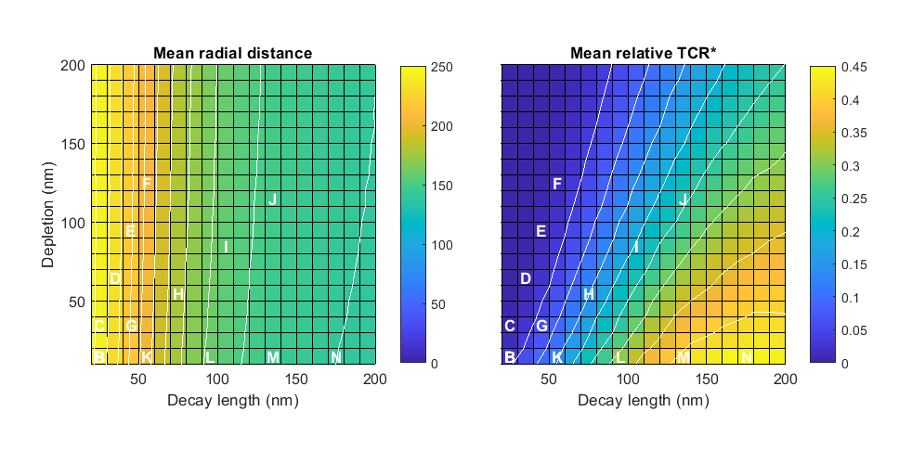
Model 3: TCR phosphorylation

Slide 15
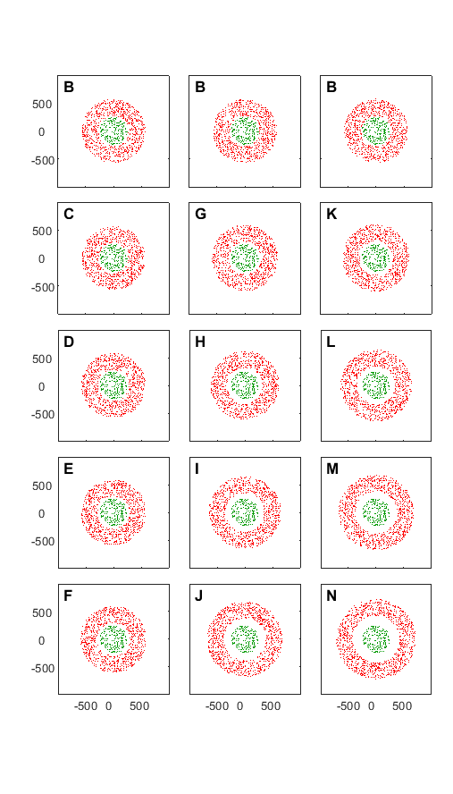
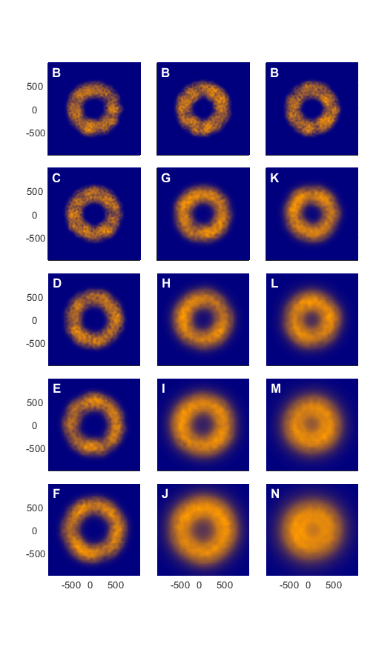
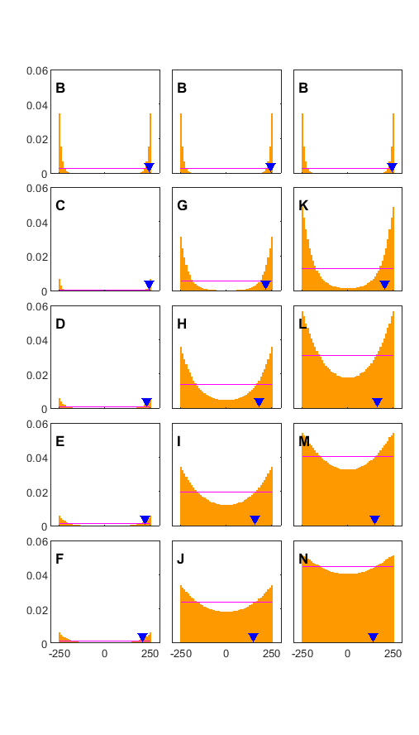
Model 3: TCR phosphorylation

Slide 16
Summary
Three models:
Kinetic segregation
Lck activation
TCR phosphorylation
No two models can results in the TCR phosphorylation gradient.
The three model can, at certain parameters range.

Slide 17
Future plans
Modular metamodel: Easier to add, subtract,
connect models.
Use ‘all’ participants in the immune synapse.
Use data from different scales (time and space).

Slide 18
End

Slide 19
